Slide 1

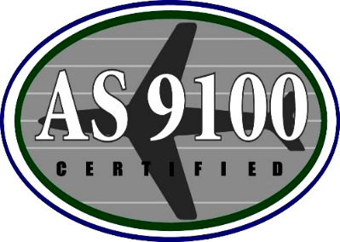

Management & Engineering Technologies International, Inc.
8600 Boeing Drive, El Paso, TX 79925
915-772-4975 | www.meticorp.com

Slide 2
Overview
Since its inception over 30 years ago, METI has been committed to delivering the highest quality of professional Advisory and Assistance Services (A&AS); Engineering and Analysis Support; Test and Evaluation (T&E) Support; IT Support Services; and Natural Resource Management to our customers.
METI, committed to quality, maintains a highly talented staff that uses a synthesis of proven and comprehensive quality and management processes to consistently deliver exceptional product and services in support of our customer’s needs and mission objectives.
Management and Engineering Technologies International, Inc. (METI)
Company | Small Disadvantaged Business Employee Owned 20% ESOP
Headquarters | El Paso, Texas
Incorporated | 1994
Facility Clearance | Top Secret
Corporate Certifications & Qualifications | AS9100D certified ISO 9001:2015 QMS DCAA Approved Accounting System Approved billing rates Government Approved Purchasing System Registered with the US Department of State and maintains an ITAR Compliance Program

Slide 3





Mission & Values
Mission
Provide customer and employee centric high-quality professional services through our talented and committed staff using industry best practices.
Values
As a SDB, diversity, equity, inclusion, and accessibility (DEIA) are rooted in the experiences of the company’s founder who continuously works to enhance DEIA in the professional services industry.
Professionalism
Integrity
Positivity
Dedication
Quality
Management & Engineering Technologies International, Inc.
3

Slide 4
Awards & Recognition
Department of Commerce’s Minority Business Development Agency,
Robert J. Brown Minority Business Enterprise of the Year Award
U.S. Department of State – Registered and maintains ITAR compliance
WASH STEWARD Infrastructure - Appreciation for Successful Implementation
Federal Times - Listed as one of Nation’s Top Program Management
Support Contractors
USDA Forest Service – Exceptional CPARS on
International Forest Research, Development, Technical, and Support Services
for the Office of International Programs / AG-3187-C-17-0012
U.S. Department of Commerce - Awarded the Minority Global Technology
Firm of the Year
USDA Forest Service - Awarded the Chief’s Global Stewardship Award
for Outstanding Service
Management & Engineering Technologies International, Inc.
4

Slide 5





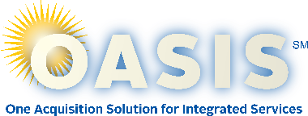








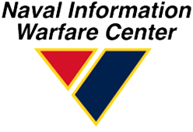
Corporate History Highlights
1994 | 1999 | 2000 | 2002 | 2006 | 2008
METI Founded | Established El Paso, TX Headquarters Entered 8(a) Program | METI received its first prime contract from the USDA, Rocky Mountain Research Station | $212M Contract for National Airway Systems Engineering Support | Received U.S. Forest Service Chief’s Global Stewardship Award | Successfully graduated from the 8(a) program
2014 | 2014 | 2015 | 2016 | 2017 | 2018 | 2018
GSA OASIS Small Business for Pools 3 and 4 | Granted authority to Operate in Ghana from the Registrar of Companies | USDA-FS Ecosystem Management Program Contract | ISO 9001:2015 Certified Quality Management System | USDA-FS International Programs Support Services Contract | Prime PASS-SB Contract | Five-year contract with U.S. Coast Guard
2018 | 2019 | 2019 | 2020 | 2020 | 2021 | 2023
Five-year contract under Seaport-NxG | DOI-International Technical Assistance Program Contract | Presented with Robert J. Brown Minority Business Enterprise of the Year Award | USAF-Cyber Security 557th Weather Wing Contract | USDA-FS NFS Support Services Contract | 7-year contract in support of NIWC PAC 551 ESS NIST Programs | USDA-FS International Programs Support Services Contract
Management & Engineering Technologies International, Inc.
5

Slide 6
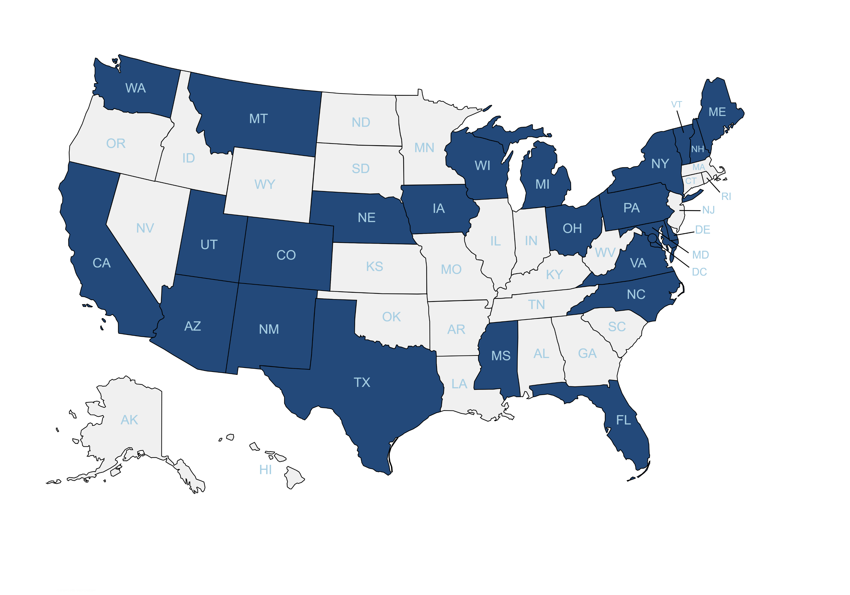
CONUS Presence
METI has a presence in over 20 states and is licensed to operate in all 50 states.
Management & Engineering Technologies International, Inc.
6

Slide 7
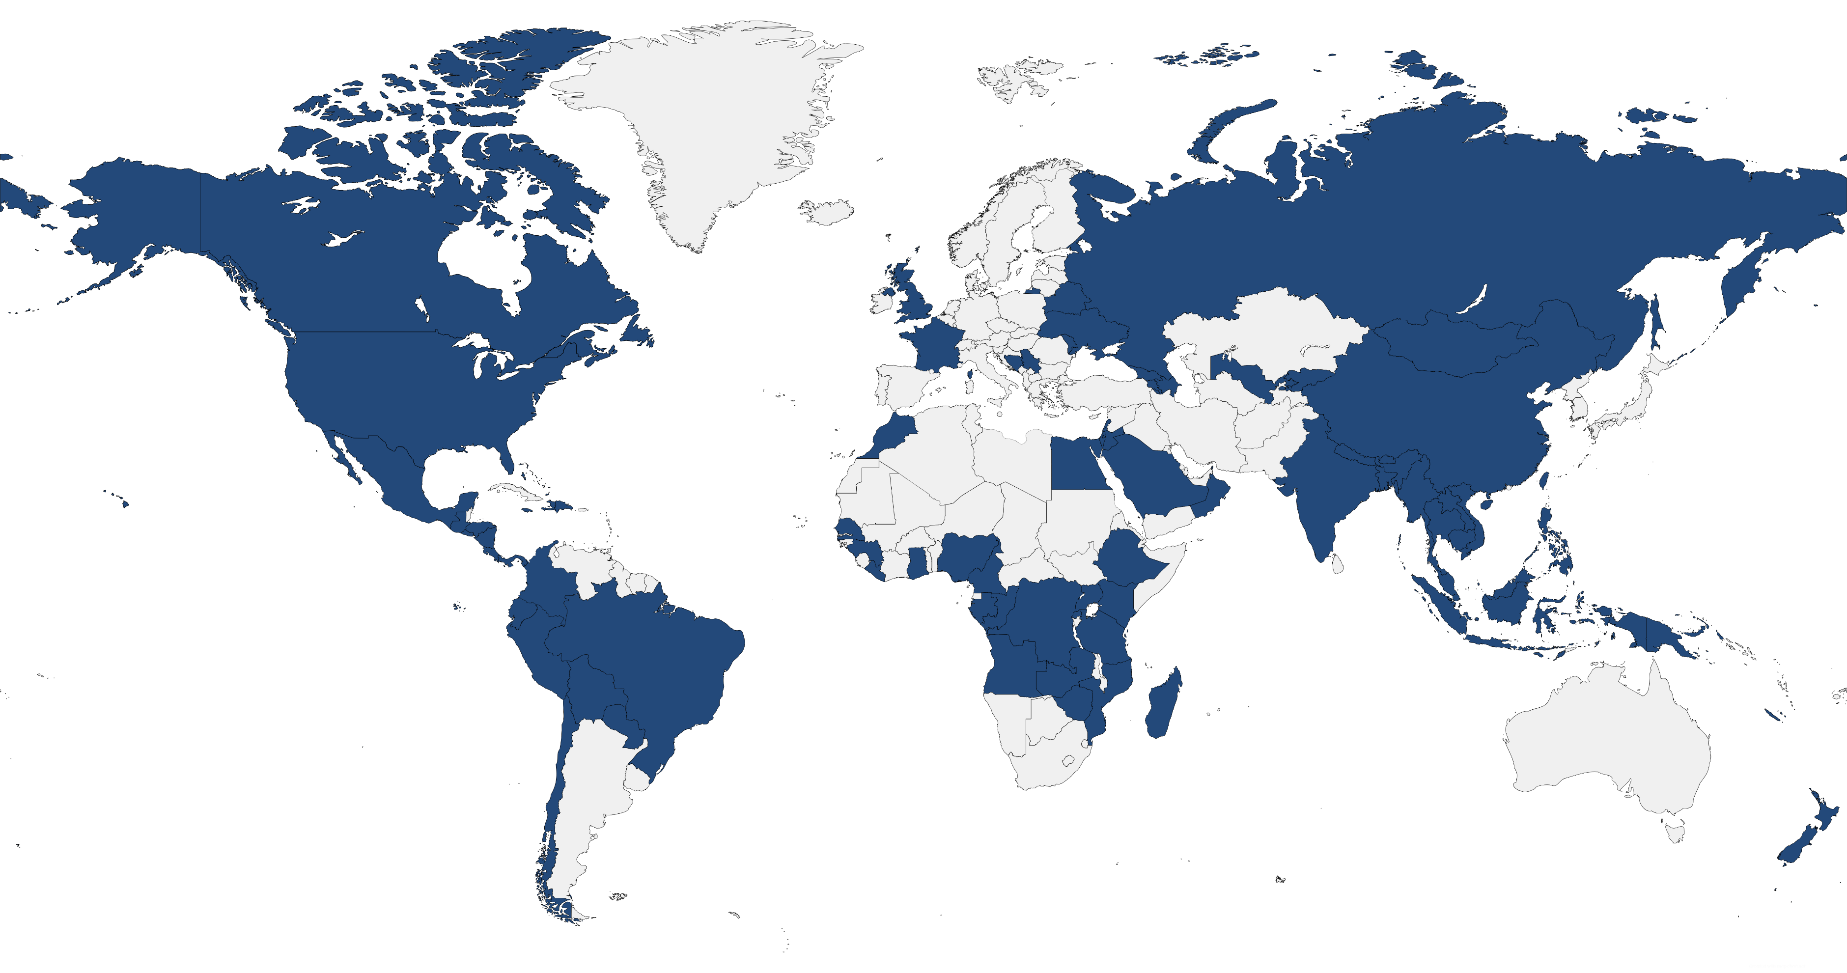
International Presence
Over the last 5 years we have supported customer projects in over 80 different countries and are currently active in over 16 different countries.
Management & Engineering Technologies International, Inc.
7

Slide 8














Customers Supported
U.S. Agency for International Development (USAID)
U.S. Department of Agriculture (USDA)
Forest Service (USFS)
Department of Homeland Security (DHS)
  U.S. Coast Guard
Department of State (DOS)
Department of Agriculture
Federal Aviation Administration (FAA)
Department of Interior (DOI)
National Interagency Fire Center (NIFC)
Department of Defense (DOD)
  U.S. Army
    NETCOM
    CECOM
  U.S. Air Force
    Air Force Materiel Command
    (HQ AFMC)
    AF Air Combat Command 557th
    Joint Interoperability Test Command (JITC)
  U.S. Navy
    Naval Air Systems Command (NAVAIR)
    Naval Information Warfare Systems Command (NAVWAR)
Management & Engineering Technologies International, Inc.
8

Slide 9


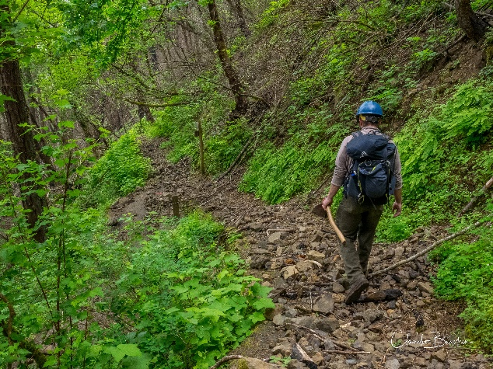



METI Core Capabilities
Provides Program & Financial Management, support of U.S. and Foreign Governments and associated agencies and overseas offices, Disaster and Humanitarian Assistance, International Natural Resource Management, and Business Operations Facilitation in over 80 countries worldwide.
Comprehensive engineering and analysis expertise encompasses the product’s lifecycle that includes concept development, requirement evaluation, testing, verification, validation, acceptance, and end-user support.
International
Programs
Systems
Engineering & Analysis
Provides innovative solutions and natural resource management technical expertise that support the USDA Forest Service and the USFS-IP programs both nationally and internationally.
Superior management, financial, engineering and technical services, and administrative support services ensure the successful execution and sustainment of our customers’ mission objectives and goals.
Natural
Resource Management
Advisory &
Assistance Services
Comprehensive IT systems and services capabilities follow industry best practices for IT systems development and integration that deliver superior solutions to our customers.
Test and Evaluation capabilities comprise the full spectrum of T&E support services that includes test planning, execution, data collection, reporting, logistics, and analysis solutions for our customers.
Information
Technology
Test &
Evaluation
Management & Engineering Technologies International, Inc.
9

Slide 10
International Programs
As a renowned professional services company, Management and Engineering Technologies International, Inc. (METI) has established itself as a trusted partner in delivering exceptional solutions worldwide. Our commitment to excellence is exemplified by our largest customer and contract, which reflects the depth of our expertise and the quality of our services. Since our support to the International Programs contract work began, METI has been instrumental in supporting international employee and consultant projects spanning over 80 countries, demonstrating our global reach and impact. With over 30 years of dedicated service as a Federal Contractor and particularly during our time supporting the Office of International Programs, METI has earned a reputation for reliability, innovation, and integrity in every endeavor we undertake. Our unwavering dedication to exceeding client expectations and driving positive change underscores our position as a leader in the industry, poised to tackle the most complex challenges and deliver sustainable solutions on a global scale.
In our International Programs work METI has provided expertise in the following 5 core areas, among others:
Program Management / Financial Management / Advisory & Assistance Services
Support of U.S. and Foreign Governments and Associated Agencies and Overseas Offices
Disaster and Humanitarian Assistance
International Natural Resource Management (NRM)
Business Operations Facilitation
Management & Engineering Technologies International, Inc.
10

Slide 11
International Programs
Program Management / Financial Management / Advisory & Assistance Services
Through meticulous program management, METI optimizes resources, streamlines processes, and monitors progress to guarantee the timely and effective implementation of initiatives. Financial management is a cornerstone of our operations, where we leverage our expertise to allocate resources judiciously, track budgets, and ensure fiscal responsibility. Our commitment to financial transparency and accountability enables the USFS and its international partners to confidently invest in sustainable forestry practices and conservation efforts.
Some examples of METI support include:
Opening and sustaining offices
Policy Analysis & Development
Financial Management / Fiscal Responsibility support
Management & Engineering Technologies International, Inc.
11

Slide 12
International Programs
Support of U.S. and Foreign Governments and Associated Agencies and Overseas Offices
METI collaborates closely with various US Federal agencies and through our International Programs work we extend our services to foreign governments such as Ghana, Jordan, and many others, fostering international partnerships and enhancing global cooperation. With our extensive expertise and commitment to excellence, METI offers comprehensive overseas program support, ensuring seamless operations and facilitating effective communication and collaboration across borders.
Examples of the breadth and depth of agencies, departments, and Governments supported include:
United States Department of Agriculture (USDA), Department of Defense (DOD), Department of State (DOS), Department of Interior (DOI), and Forest Service (USFS)
Bangladesh Forest Department
Office of Defense Coordination (Vietnam)
Nigeria Emergency Management Agency (NEMA)
State Emergency Management Agencies (SEMA)
Governments of Ghana, Jordan, Vietnam, Peru, Madagascar, Zimbabwe, Mozambique, Bangladesh, India, Angola, Nepal, Gabon, Nigeria, Indonesia,
Royal Government of Bhutan (RGOB), Democratic Republic of Congo (DRC), and Central Africa Republic (CAR)
Management & Engineering Technologies International, Inc.
12

Slide 13
International Programs
Disaster & Humanitarian Assistance
METI has been on the forefront of disaster assistance since 2004. We have provided a wide range of disaster response, management, planning, infrastructure construction, operations, preparedness, and prevention on contracts with the U.S. Department of Agriculture (USDA), U.S. Forest Service Office of International Programs (USFS-IP), the Federal Aviation Administration (FAA), and other initiatives funded by the U.S. Agency for International Development (USAID), Office of U.S. Foreign Disaster Assistance (OFDA).
METI supports Disaster Assistance Support Programs (DASP) / Bureau for Humanitarian Assistance (BHA) efforts by providing critical expertise and resources in times of crisis. Through our collaborative efforts with the programs, we contribute strategic planning, logistical support, and emergency capabilities to ensure an effective and efficient humanitarian response. By leveraging our skills and resources in disaster management, METI plays a vital role in enhancing the program's ability to provide timely and lifesaving assistance in the face of emergencies.
METI's team excels in rapid needs assessments, enabling the programs to swiftly deploy resources and personnel to areas affected by disasters. Our comprehensive approach encompasses project management, financial oversight, and technical support, ensuring that the Humanitarian Response Support Program can respond promptly and effectively to alleviate the impact of disasters on affected communities. In support of International Disaster & Humanitarian Assistance, METI has:
Recruited, hired, and onboarded experienced staff to fill specialized disaster management roles for the Disaster Assistance Support Program (DASP) humanitarian response programs and initiatives.
Provided talented individuals to implement disaster management capacity building training programs for host country governments.
Successfully had individuals support civilian humanitarian response contexts.
Coordinated roles with the US military and worked with those individuals to navigate travel security, and other administrative requirements.
Supported USAID/BHA with leadership and change management experts who have provided senior leaders with methods to set and achieve milestones during the reorganization of the agency.
Management & Engineering Technologies International, Inc.
13

Slide 14
International Programs
International Natural Resource Management (NRM)
As a globally recognized leader in providing Natural Resource services, METI, Inc. has the capacity and technical expertise to provide unparalleled management support for domestic and international program needs. METI’s science application subject matter experts provide a blend of managerial and leadership experience to improve clients’ efforts in collaborative management, applying risk management techniques, and improving organizational effectiveness. This expertise allows METI to provide client-focused approaches to improve science use and achieve compliance with mandates for science-based land management.
METI International NRM efforts include projects dealing with:
Climate Change
Illegal Logging
Invasive Species
Watershed Management
Forest Planning and Monitoring
Migratory Species
Conservation Education
Fire Management
Monitoring and Evaluation
Training/Workshops/Videos
Protected Area / Habitat & Ecosystem Management
Management & Engineering Technologies International, Inc.
14

Slide 15
International Programs
Business Operations Facilitation
METI specializes in Business Operations Facilitation, providing comprehensive support across various domains crucial for organizational success. From facilitating effective communications and providing professional writing services to managing human resources and upholding human rights standards, we ensure smooth and efficient operations. Our expertise extends to Information Technology and Database support, offering seamless integration and management of digital resources. Additionally, we provide interpretation and translation services to bridge linguistic barriers, facilitate payment processing, and oversee general office management / administration, including event coordination. With METI's tailored solutions, organizations can streamline their operations and focus on achieving their strategic objectives.
Examples of METI’s Business Operations Facilitation experience includes work in the areas of:
Communications
Writing
Human Resources
Human Rights
Information Technology and Database Support
Interpretation / Translation Services
Payment Processing
General Office Management /
Admin Support / Events
Management & Engineering Technologies International, Inc.
15

Slide 16
Natural Resource Management
For over 25 years, METI’s subject matter experts have applied science, technical, and management expertise to develop innovative approaches that assist Federal customers with addressing natural resource and community issues. Our Natural Resource experience comes from OCONUS and CONUS projects. METI delivers natural resource management services to the USDA Forest Service and the USAID, both domestically and internationally, in support of a range of programs such as:
Task Areas Supported
Management and Business Support
Facilitation and Coaching
Stakeholder Meeting Design & Logistics
Graphics Design and Presentation Materials
National Policy Support
Planning, Collaboration, and National Environmental Policy Act (NEPA)
Natural Resource Economics and Social Assessments
Natural Resources Management
Natural Resource Data Acquisition and Survey Support
Management & Engineering Technologies International, Inc.
16

Slide 17
Information Technology
METI provides IT support that includes expertise in the following areas:
Enterprise Architecture
Systems Engineering & Administration
Help Desk
Configuration & Data Management
Application Development
Website Design & Development
Cyber Security & Information Assurance
Network Engineering & Administration
Operation & Maintenance
RMF / Certification & Accreditation
Management & Engineering Technologies International, Inc.
17

Slide 18
Systems Engineering
& Analysis
METI consistently provides our DOD customers with superior system engineering and analysis support that includes the following subjects:
Concept of Operations Development
Requirements Engineering & Management
Specification & Interface Development
Decision Analysis & Trade Studies
Feasibility Studies & Analysis
Independent Validation, Verification & Accreditation
Acceptance Testing
Reliability, Availability, Maintainability, & Safety
Management & Engineering Technologies International, Inc.
18

Slide 19
METI Advisory & Assistance Services
METI consistently provides our customers with outstanding Advisory and Assistance Services that includes supporting the following subjects:
Program Management
Acquisition Lifecycle Management
Research & Development
Test & Evaluation
Configuration Management
Logistics Support & Fielding
Management & Engineering Technologies International, Inc.
19

Slide 20
METI Test & Evaluation
METI has a history of providing Test and Evaluation support that includes the following Fields, Disciplines, and Activities:
Planning
  Cost Estimating
  Schedule Development
  Logistics
Test Article Prototype and Fabrication
Set Up
Modeling & Simulation
Systems Operability Testing
System of Systems (SoS) Testing and Evaluation
Execution
  Field Support
  Facilities Support
  Instrumentation
  Data Collection
Documentation
Purchasing
Inventory
Management & Engineering Technologies International, Inc.
20

Slide 21


Recognition
“METI provided exceptional quality. The contractor reliably supported USFS International programs (USFS/IP) work with professional and quality staff that possessed a wide range of expertise, ranging from fire and disaster management to forest restoration. METI was also able to contribute individuals with advanced language capabilities. METI consultants and home office staff in El Paso worked tirelessly to ensure all activities were started and completed on schedule and completed on schedule and within budge.”
Contracting Officer’s Representative - USDA-FS, International Programs
“METI as extremely flexible and easy to communicate with. They provided information and answers quickly. Took it upon themselves to create interpersonal relationships with the Coast Guard staff by travelling to Oakland, CA for an in-person visit, showing care and investment in the well-being of the contract.”
Contracting Officer - DHS-USCG, HM&E support
“The administrative and support staff of Management Engineering and Technologies International, Inc. (METI) were exceptional: always helpful, always the utmost professionals, always willing to roll up their sleeves to help in any and every way. This technical guide would not have been possible without the coordination, oversight, thoughtfulness, and care provided by these staff.”
Contracting Officer - USDA-FS, Ecosystem Management Program
“Without our partnership with METI, we could not have achieved the things we have accomplished over the last four years, and we would not have fulfilled our mission. Your highly efficient and customer service-oriented staff has been a pleasure to work with.”
Dr. Val Mezainis, Director - USDA-FS International Programs
Management & Engineering Technologies International, Inc.
21

Slide 22
Contract Vehicles
Vehicle | Prime / Sub | Services
GSA OASIS SB | Prime | Engineering Services, and Research and Development
MAS (Multiple Award Schedule) FSC, 541611 | Prime | Management and Financial Consulting, Acquisition and Grants Management Support, and Business Program and Project Management Services
Navy Seaport-NxG | Prime | Engineering, Financial, and Program Management
FAA eFAST | Prime | Air Transportation Support, Research & Development, and Engineering Services
Management & Engineering Technologies International, Inc.
22

Slide 23
Points of Contact
Renard U. Johnson
President / CEO
rjohnson@meticorp.com
Ernest Osborn
Sr. Vice President, DOD/DHS Programs
eosborn@meticorp.com
Dairen Sanchez
Business Development Manager
dsanchez@meticorp.com
8600 Boeing Drive, El Paso, TX 79925
915-772-4975 | www.meticorp.com

